Slide 1
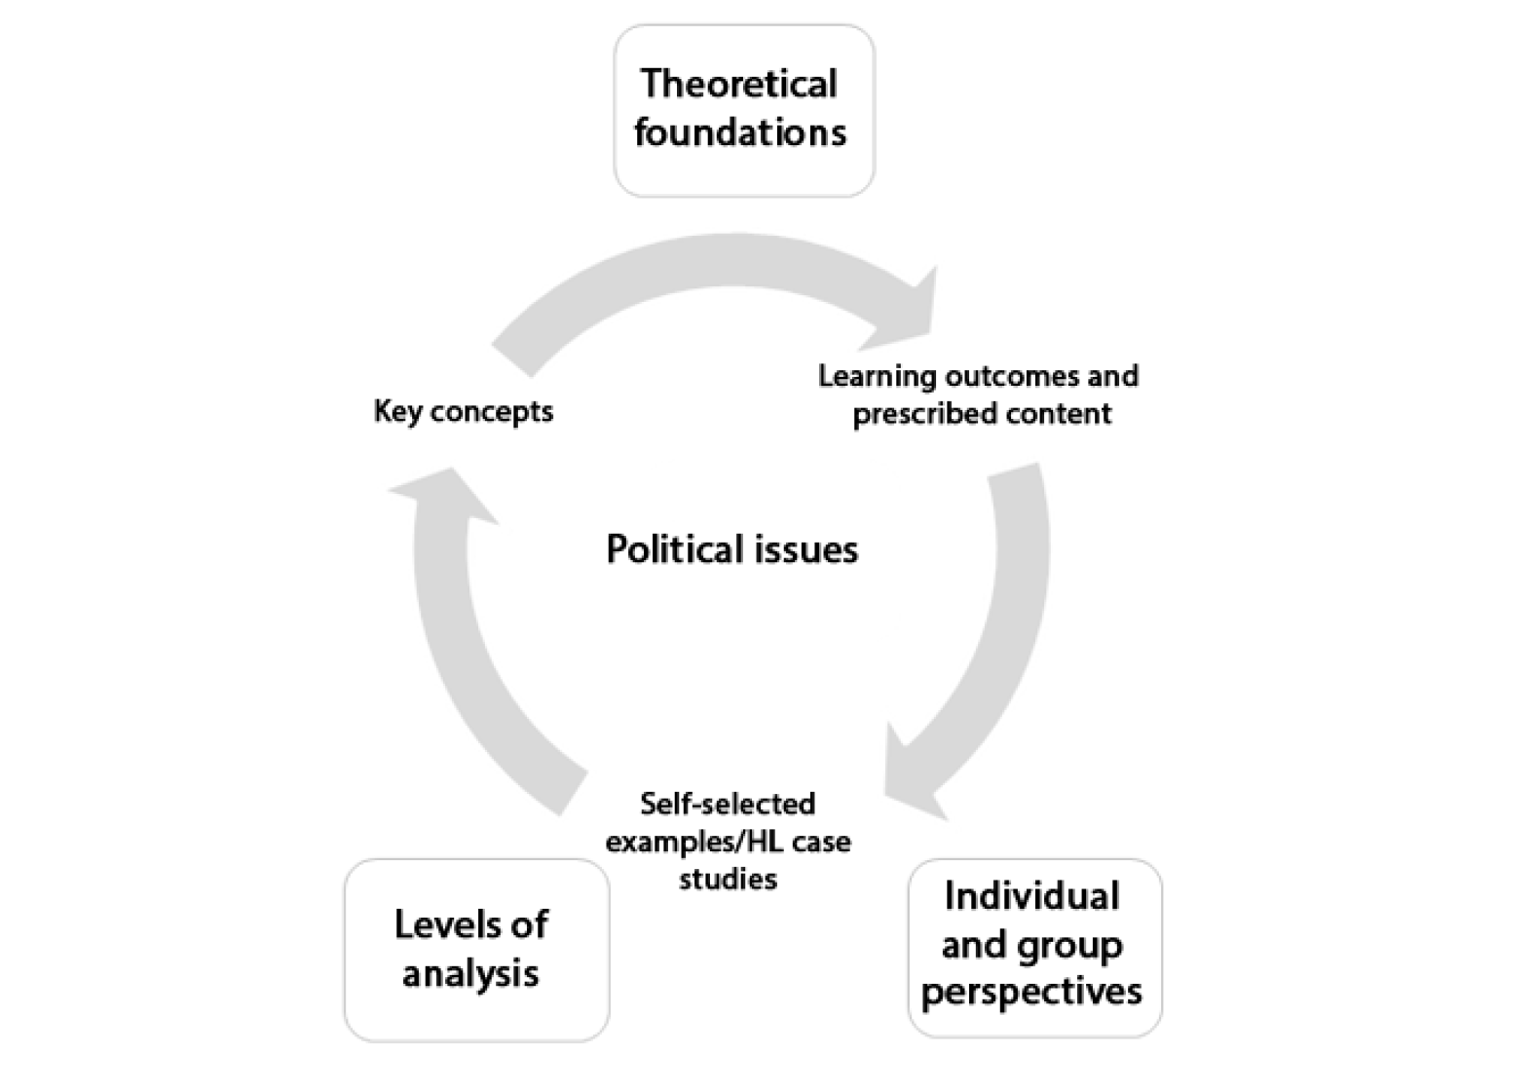
Theory: Realism vs. Liberalism

Slide 2
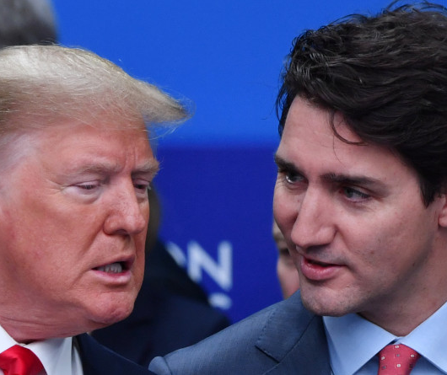
Global Politics Theories
Global politics theories give us competing interpretations of reality that help frame understanding of political issues and the actions of political actors. Some guiding questions:
What key concepts are central to this theory?
According to this theory, who are the most important actors?
What does this theory believe the 'ideal society' looks like?
According to this theory, what motivates human behaviour?
What view of progress does this theory propose?

Slide 3
Realism

Slide 4
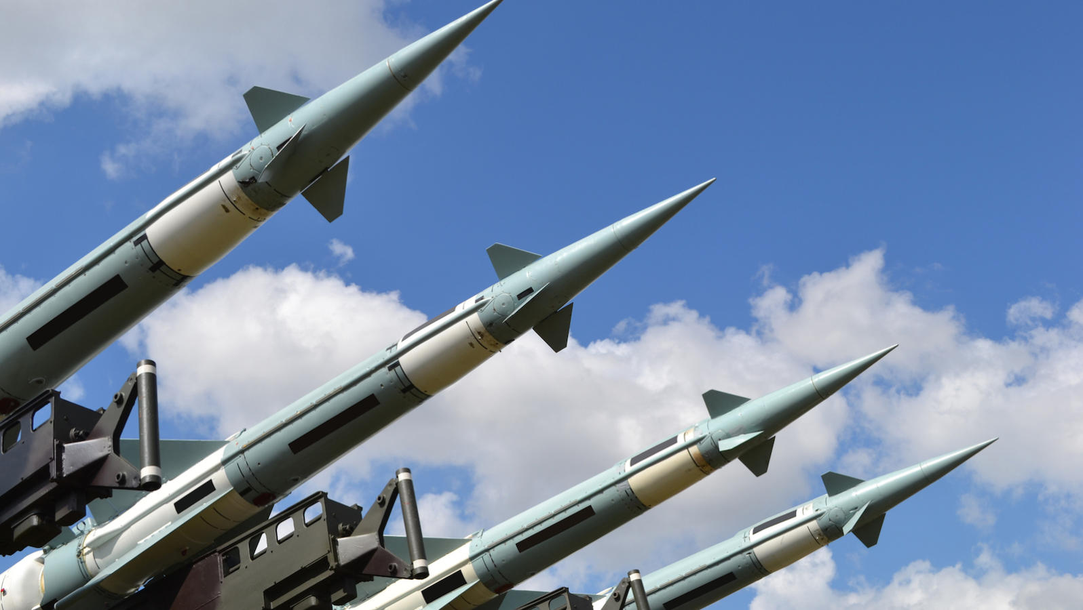
Realism
What key concepts are central to this theory?
According to this theory, who are the most important actors?
What does this theory believe the 'ideal society' looks like?
According to this theory, what motivates human behaviour?
What view of progress does this theory propose?

Slide 5
Liberalism

Slide 6
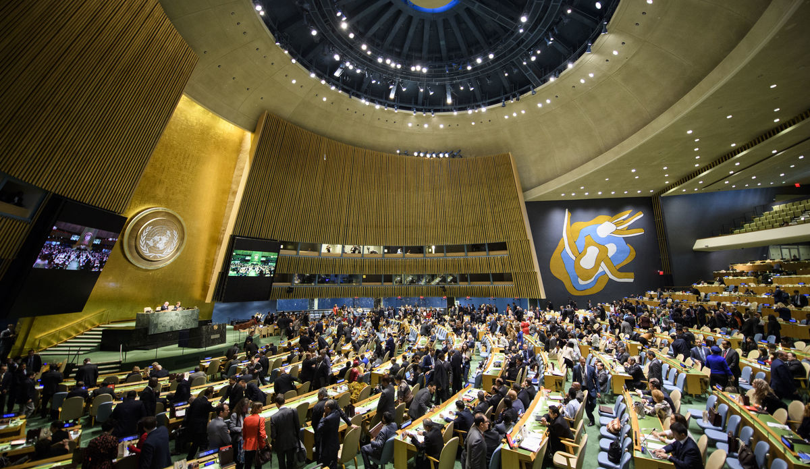
Liberalism
What key concepts are central to this theory?
According to this theory, who are the most important actors?
What does this theory believe the 'ideal society' looks like?
According to this theory, what motivates human behaviour?
What view of progress does this theory propose?

Slide 7
Capitalism as a Global Politics Theory

Slide 8
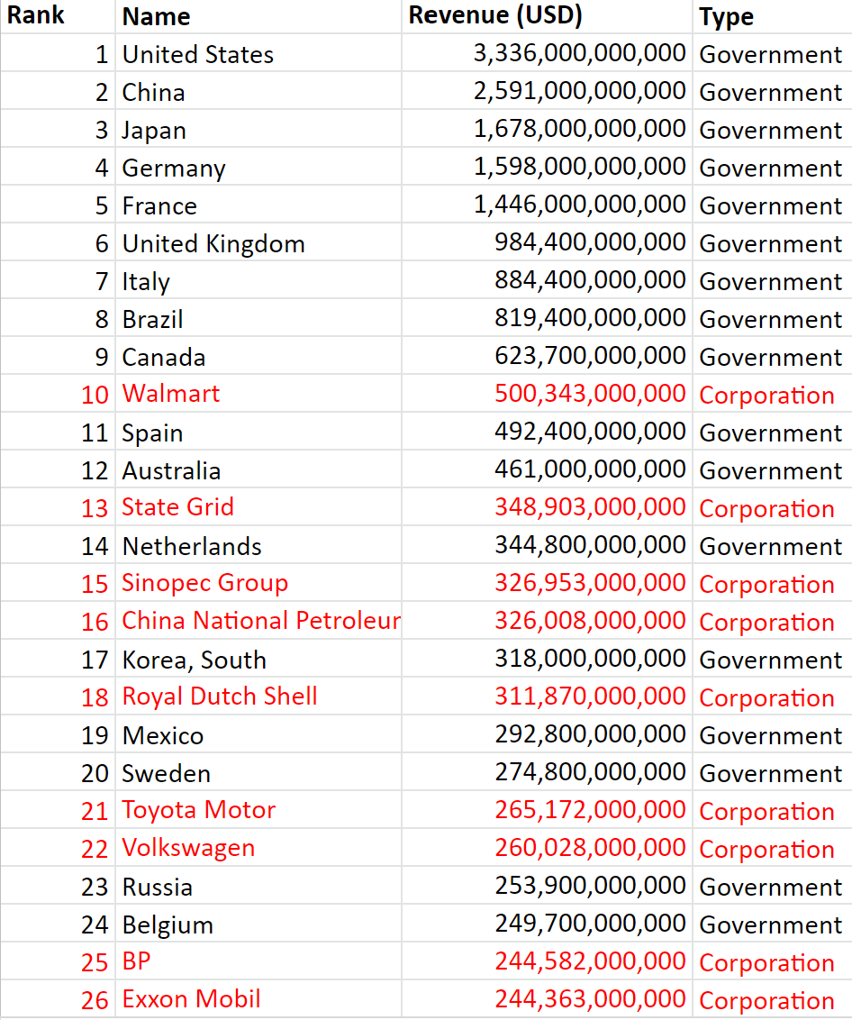

Slide 9
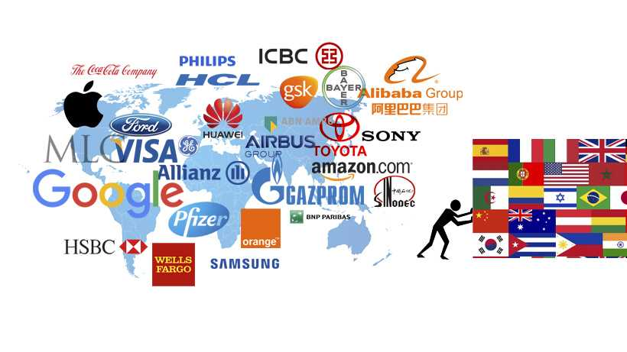
Capitalism as a Global Politics Theory
What key concepts are central to this theory?
According to this theory, who are the most important actors?
What does this theory believe the 'ideal society' looks like?
According to this theory, what motivates human behaviour?
What view of progress does this theory propose?

Slide 10
Critical Theories: Marxism

Slide 11
Critical Theories: Marxism
What key concepts are central to this theory?
According to this theory, who are the most important actors?
What does this theory believe the 'ideal society' looks like?
According to this theory, what motivates human behaviour?
What view of progress does this theory propose?

Slide 12
Critical Theories: Constructivism

Slide 13
Critical Theories: Constructivism
What key concepts are central to this theory?
According to this theory, who are the most important actors?
What does this theory believe the 'ideal society' looks like?
According to this theory, what motivates human behaviour?
What view of progress does this theory propose?

Slide 14
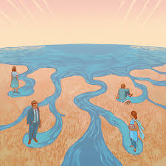
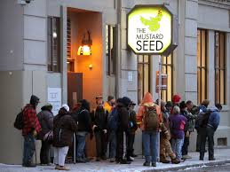
Other Critical Theories
Environmentalism
Feminism
Cosmopolitanism
Communitarianism

