Slide 1
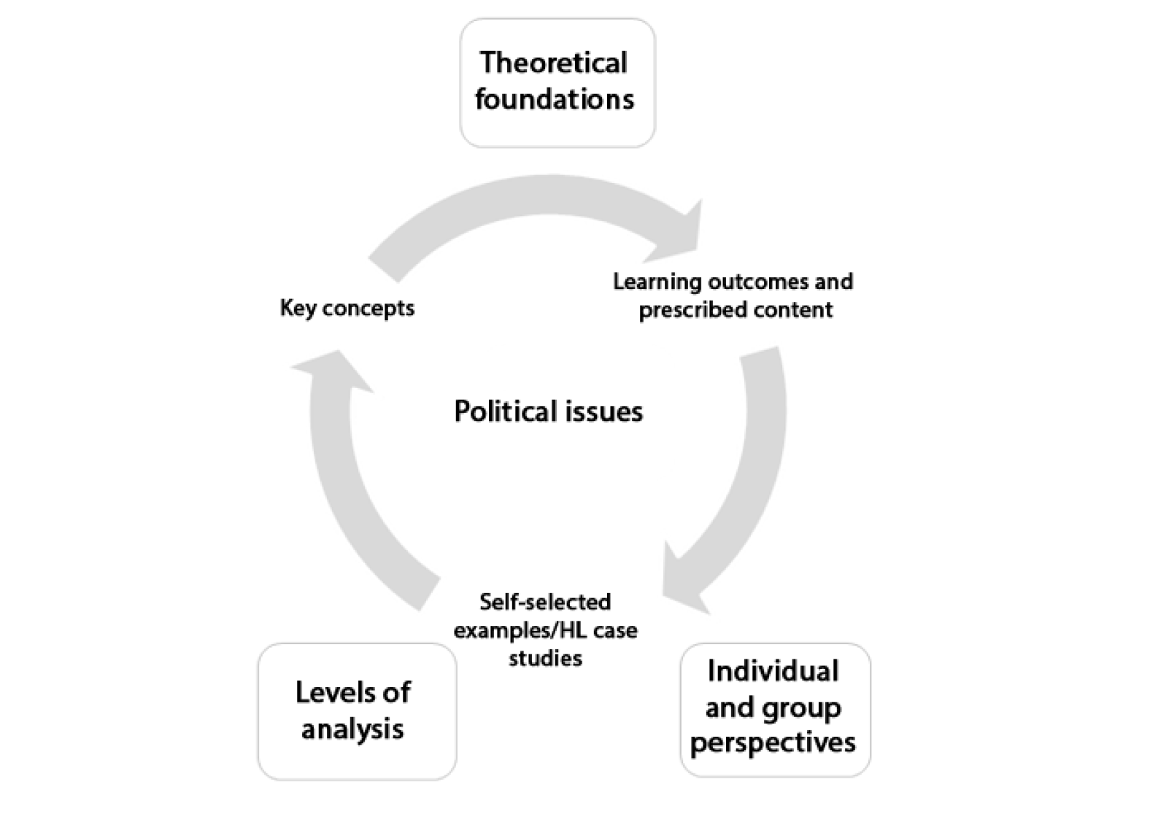
Global Politics Foundation
What is a political issue?

Slide 2
If you see this:
The information on the slide is VERY IMPORTANT – Write it in your notes

Slide 3
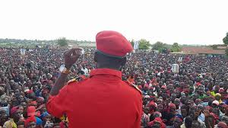
Political Issues
A political issue is any question that deals with how power is distributed and operates in society, and how people think about, and engage in, their communities and the wider world on matters that affect their lives.

Slide 4
Political Issues
A political issue is any question that deals with how power is distributed and operates in society, and how people think about, and engage in, their communities and the wider world on matters that affect their lives.
Thinking both globally and locally – who would you say has 'power' in society?

Slide 5
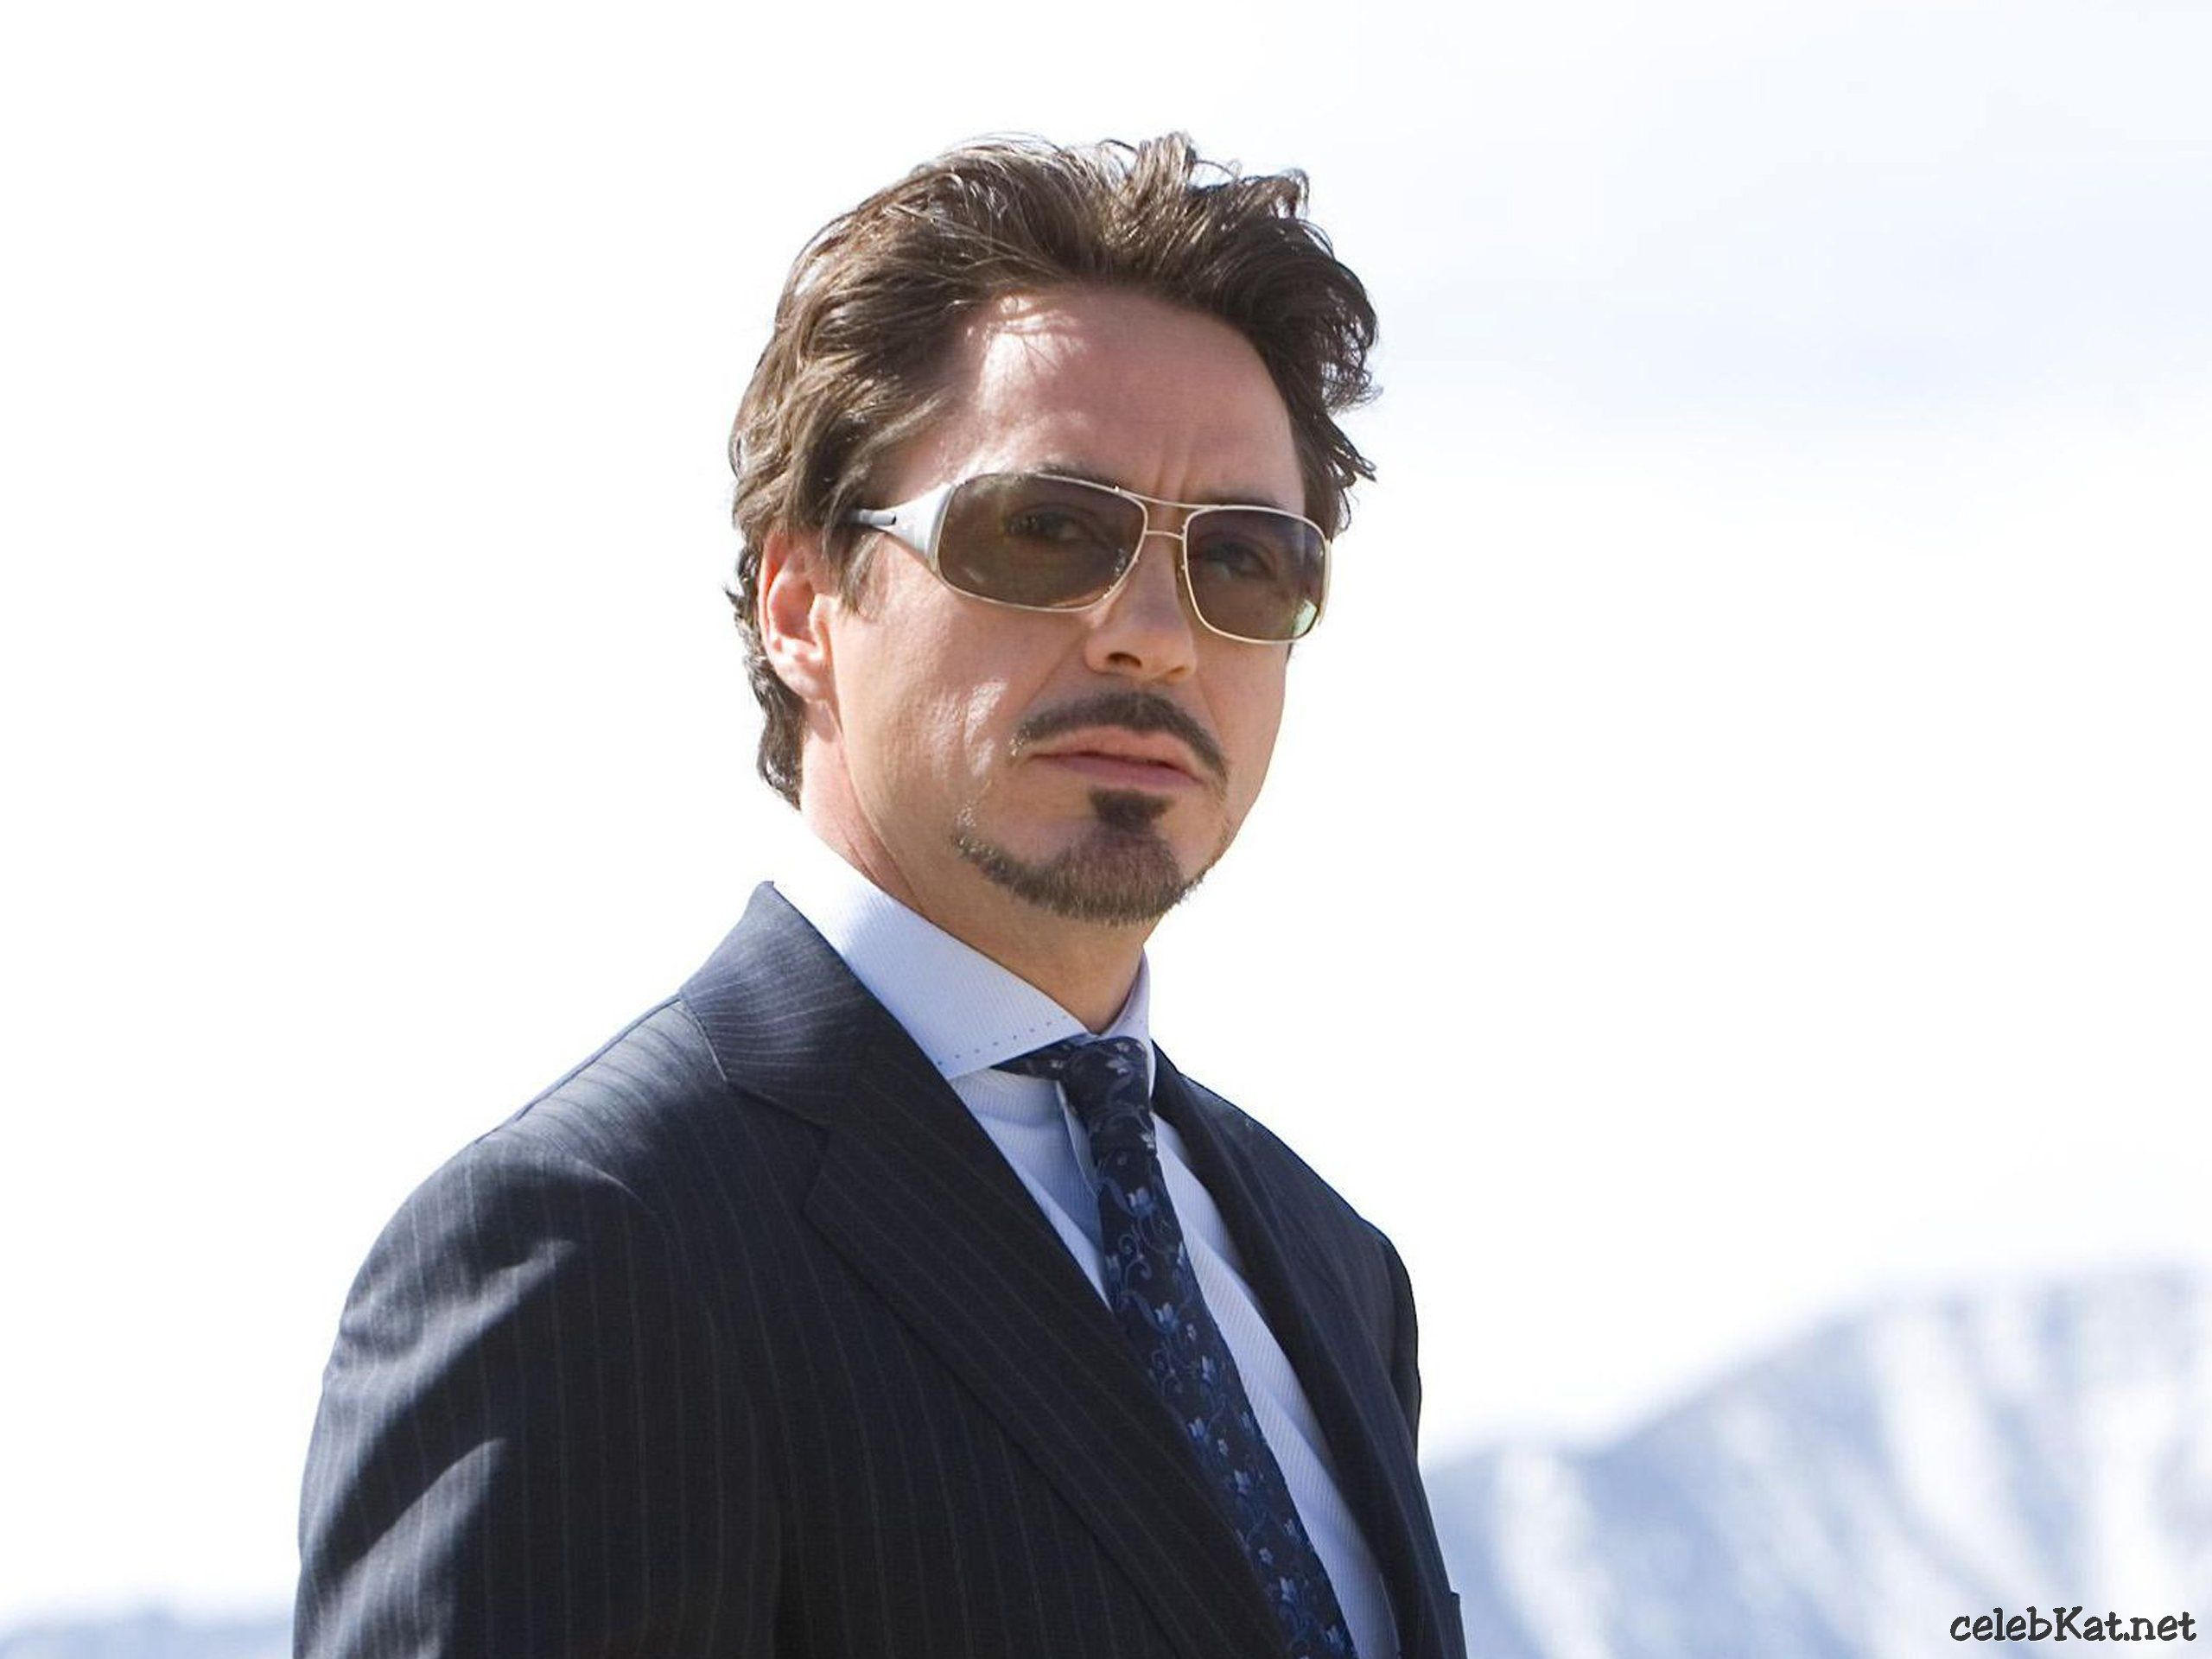
Political Issues
Actor?

Slide 6
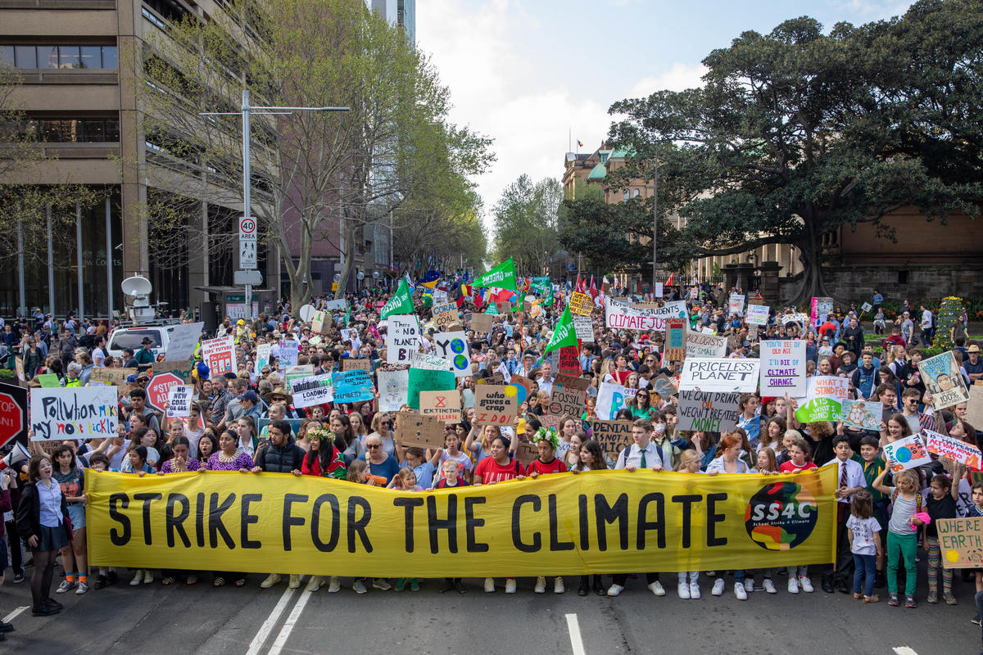
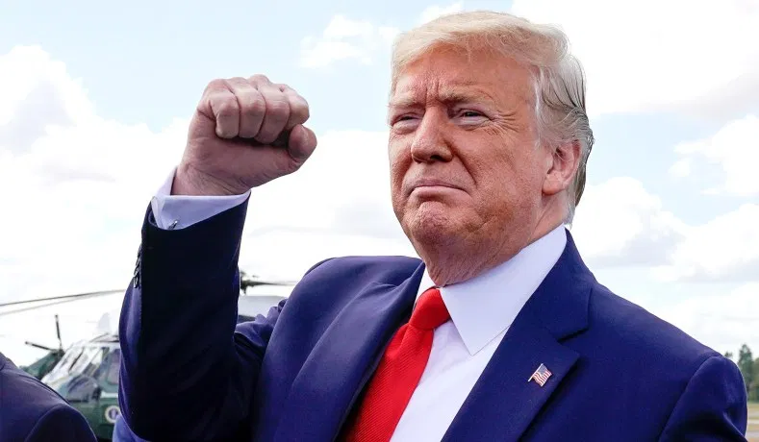
Political Issues
Actor
Any individual or entity that has enough authority and power – and has a will to exercise its power to influence political processes.

Slide 7
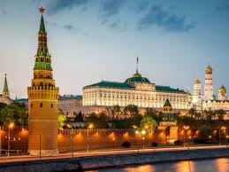
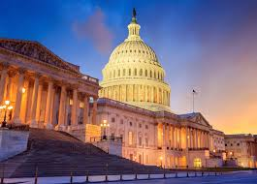
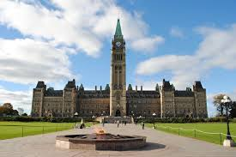
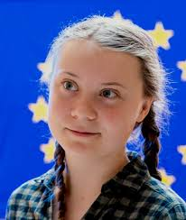
Political Issues
State Actors
State governments making political policy (foreign and domestic)
Non-State Actors
An individual or organization that has significant political influence but is not allied to any particular country or state.

Slide 8
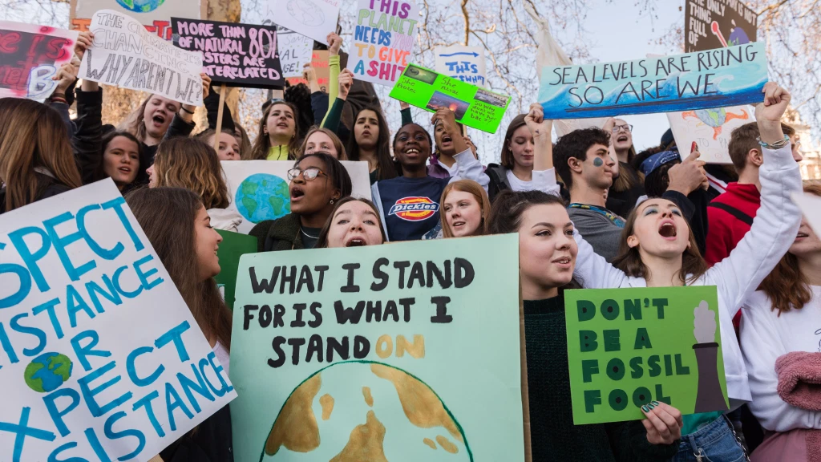
Political Issues
So – political issues are researched in social science departments and think tanks; they populate the agendas of politicians and policymakers; they occupy the minds of executives of global corporations and local social entrepreneurs; they affect how people participate in and resist change; they are discussed in media and over coffee; they inspire oratory and art; they are deeply rooted in history and culture. Political issues are part of our daily lives.

Slide 9
Key Concepts
Power | Sovereignty | Legitimacy | Interdependence
Peace | Conflict | Violence | Non-Violence
Human Rights | Justice | Liberty | Equality
Development | Inequality | Globalization | Sustainability

