Slide 1
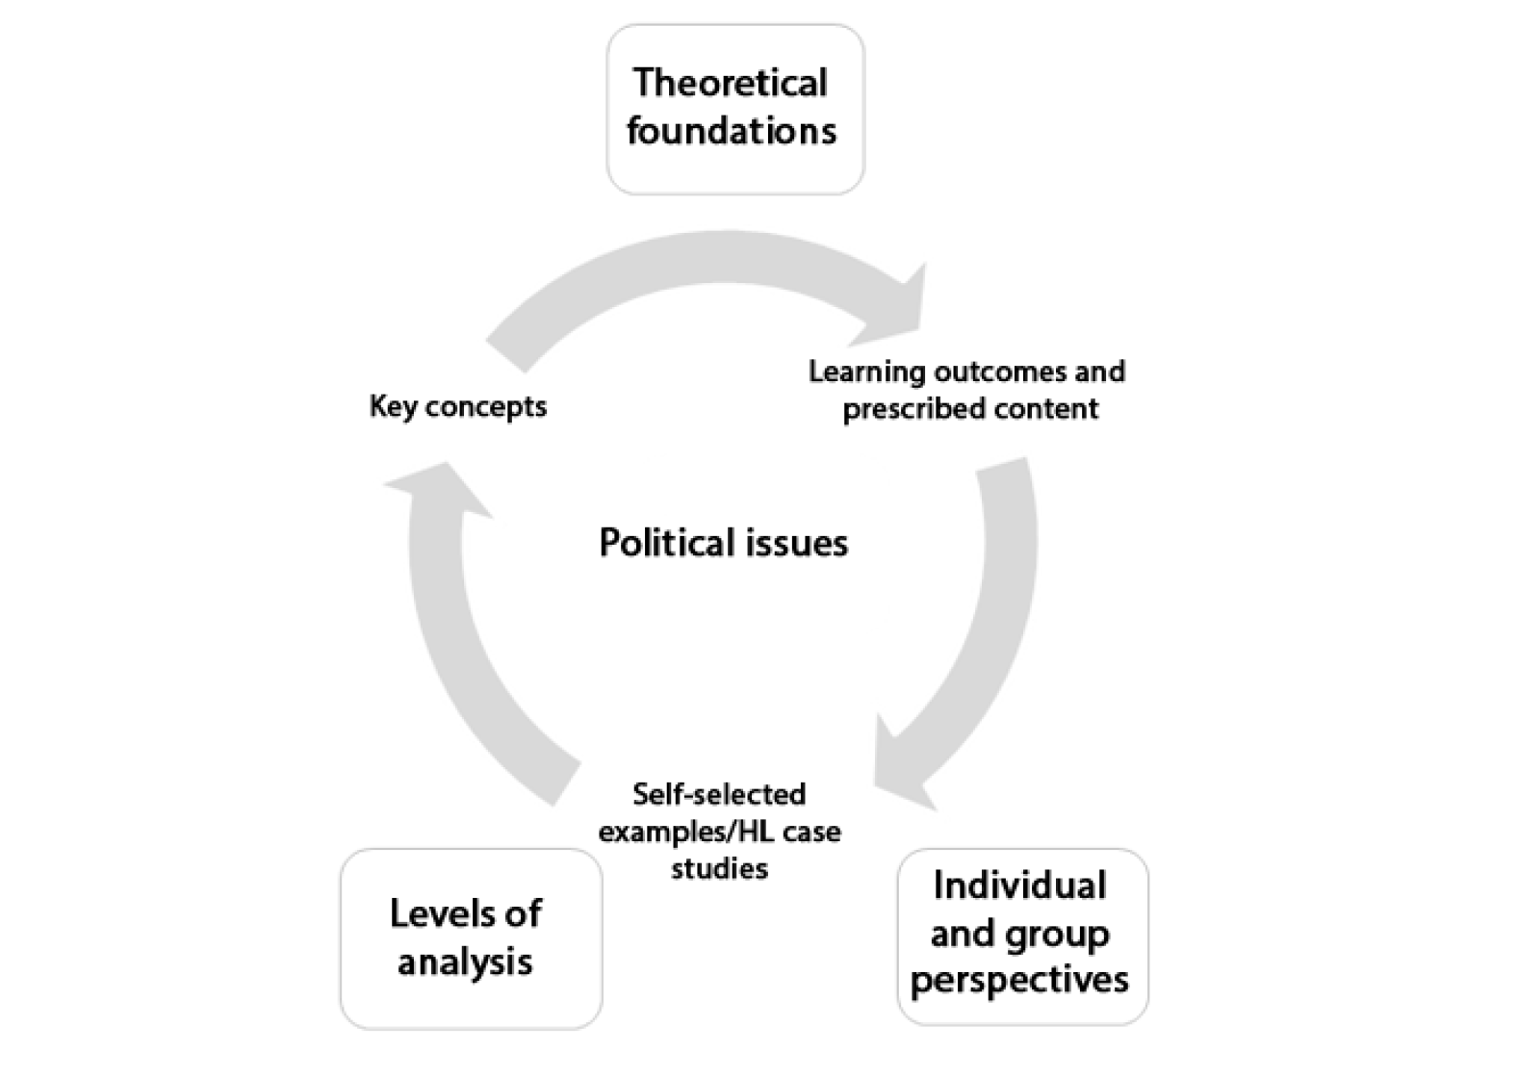
Levels of Analysis
Review: What is a political issue?

Slide 2
Key Concepts
Power | Sovereignty | Legitimacy | Interdependence
Peace | Conflict | Violence | Non-Violence
Human Rights | Justice | Liberty | Equality
Development | Inequality | Globalization | Sustainability

Slide 3
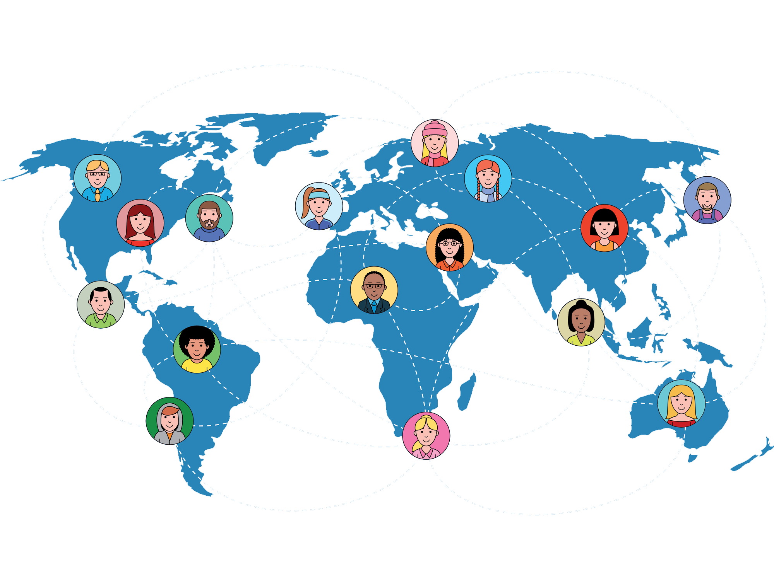
Levels of Analysis
Global

Slide 4
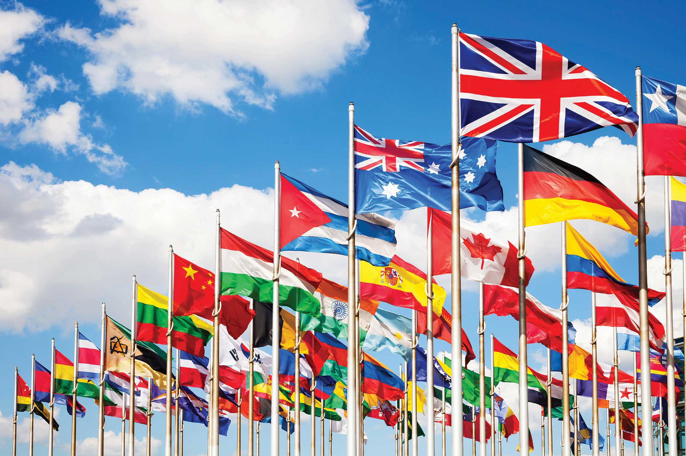
Levels of Analysis
International

Slide 5
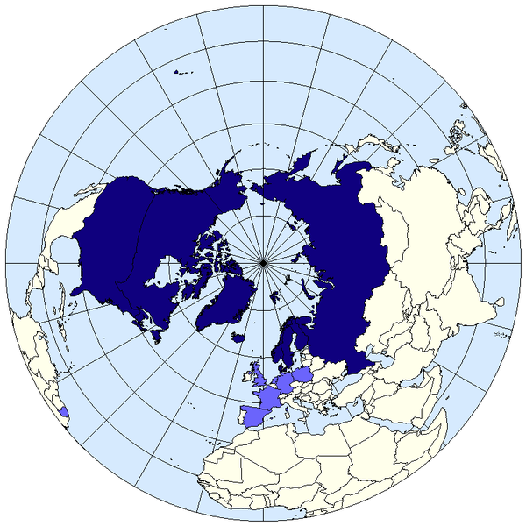
Levels of Analysis
Regional
Multinational

Slide 6
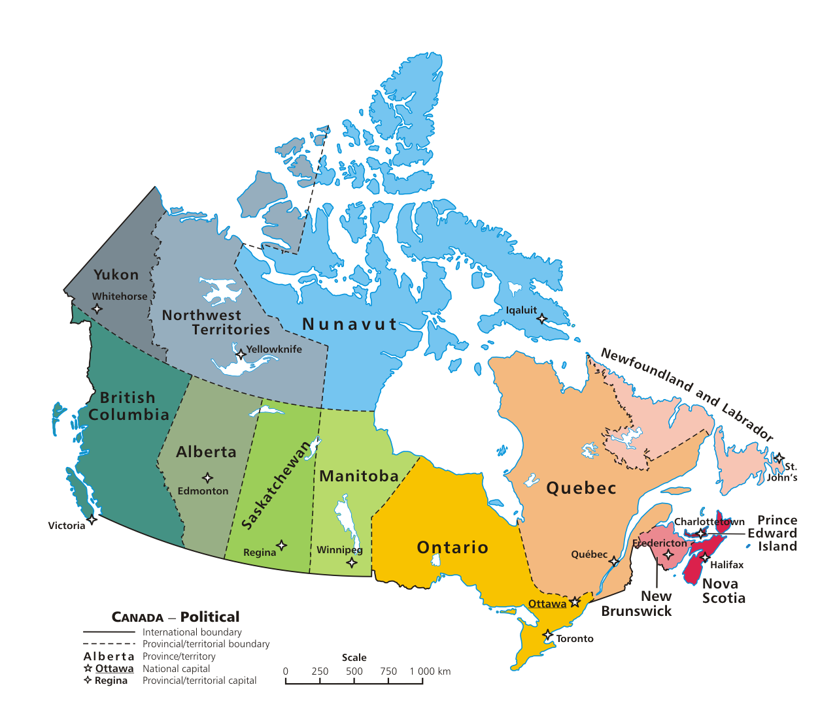
Levels of Analysis
National

Slide 7
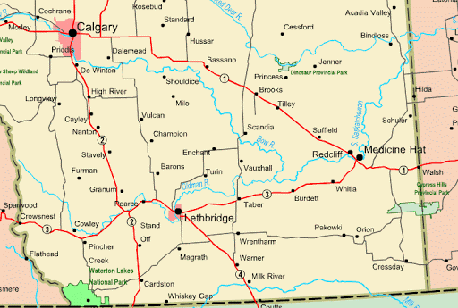
Levels of Analysis
Local

Slide 8
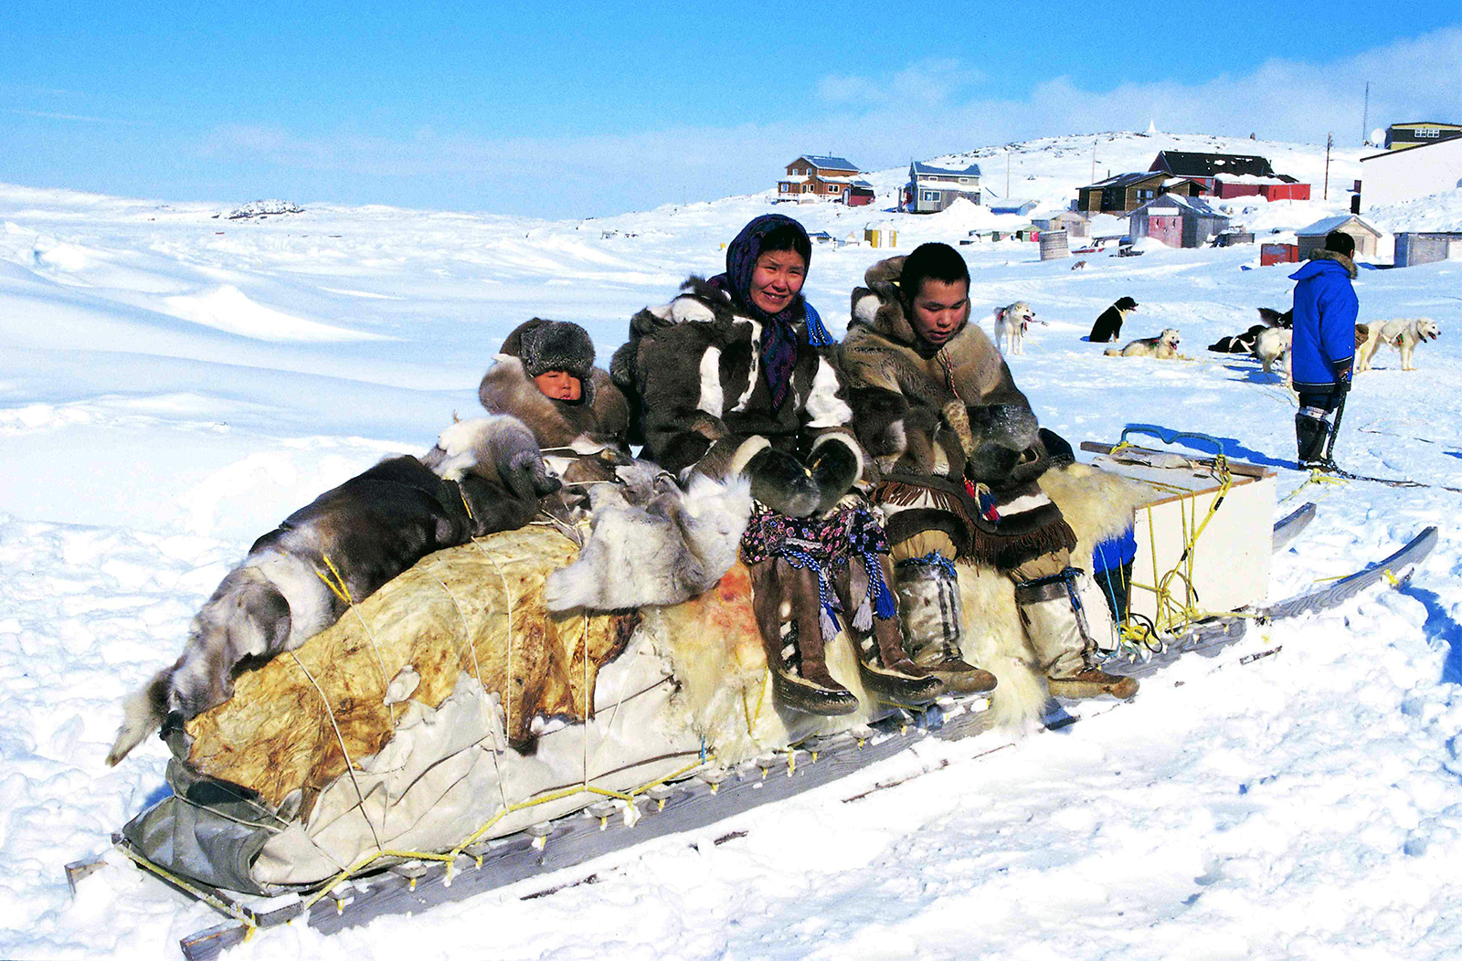
Levels of Analysis
Community

Slide 9
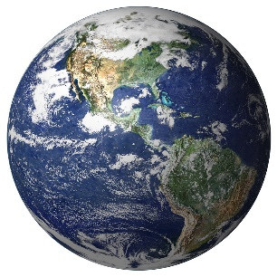
Global
Sea Levels
Changing weather patterns
Rising Avg. Temperature
International
Paris Climate Summit
Climate Change
Kyoto Protocol
UN Climate Change Summits
Regional
OPEC
Polar Ice Caps Melting
Arctic Council
National
Carbon Taxes
Resource Economies
Local
Oil & Gas Cities
Alaska/Nunavut
Community
Inuit
Scientific Community
Political debate

Slide 10
Levels of Analysis
Create a ‘levels of analysis’ chart for the ideas displayed in the symbols above.

Slide 11
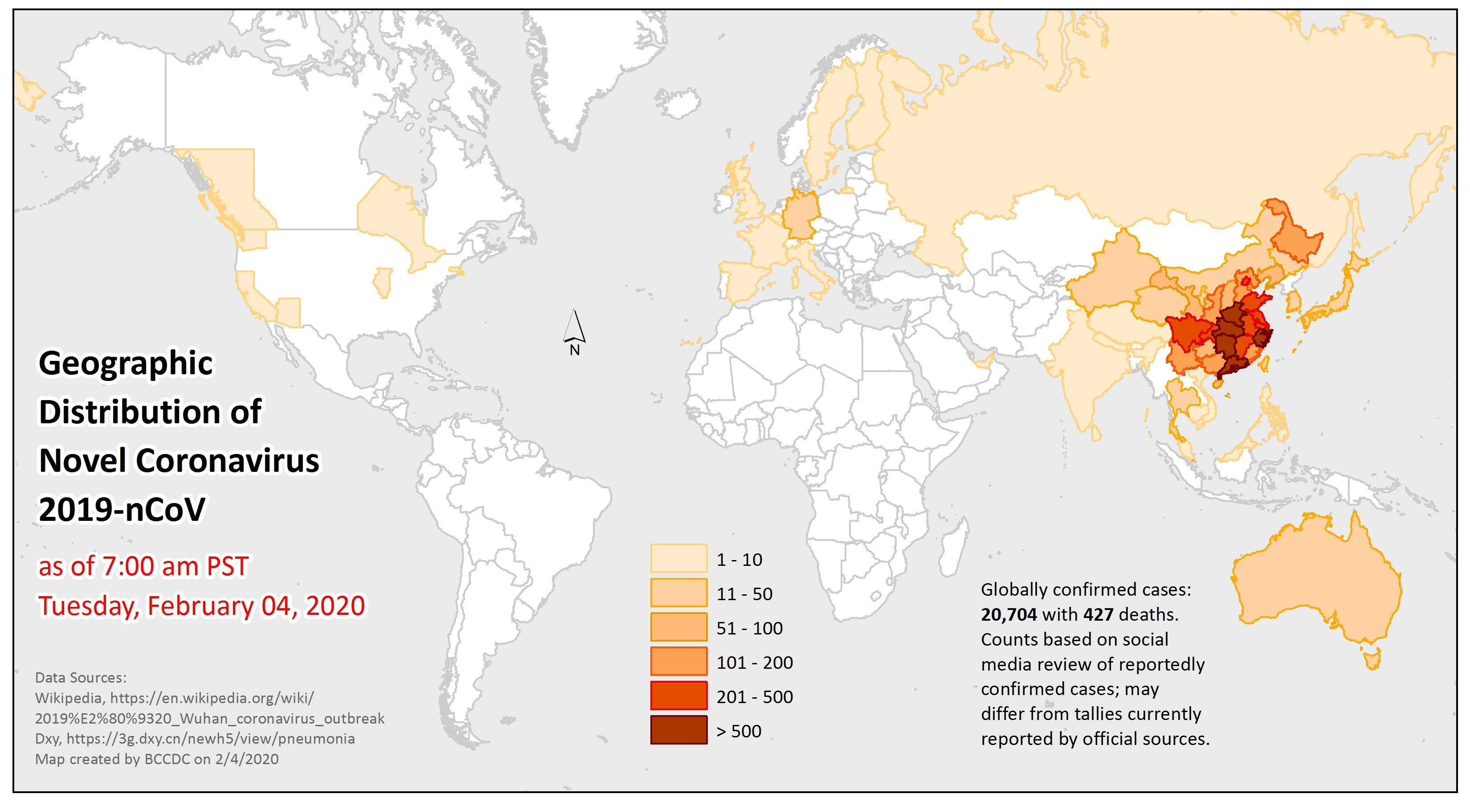
Levels of Analysis
Your task is to do a 'levels' analysis of the assigned political issue.
In a series of slides (google or PP) to be handed in on D2L:
Explain the background of the political issue
Analyse the impact of the political issue in each level
Include a list of sources consulted
Start with the provided article, then do further research.

